Slide 1

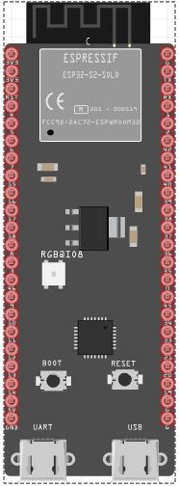
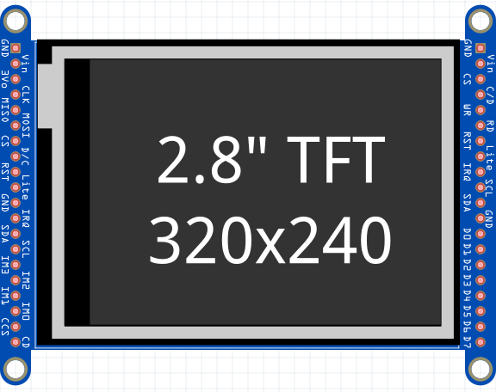
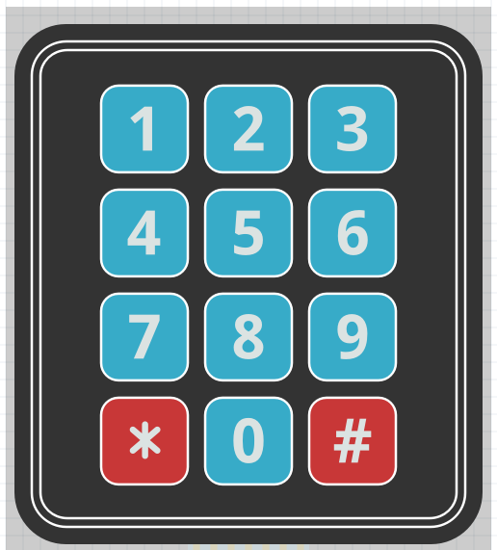
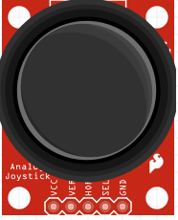
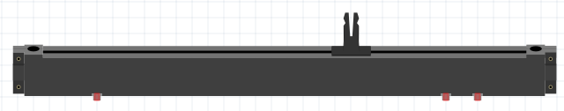
Problem Statement
User Interfaces are one of the most expensive and time-consuming part of product development and have a steep learning curve.
A plug and play panel with a start-to-finish user interface development experience
Team: Parker Sexton, Kelly Mae Allen, Will Wood, Nida Kosedagi, Abisha Fenn
Mentors: Professor Jim Carlson
System Requirements
Two wire user interface
Touchscreen Display
Interchangeable tactile buttons, knobs, and sliders
Protective enclosure
Wide MCU compatibility
Custom PCB for Main Board and Peripherals
Cost ~ $100
User Flow
User Designs Layout
Website Generates String
Device requests profile
String decoded into components
System Architecture Diagram
User
System
Website
UART
ESP 32
Design Challenges
Dynamic Code Structure
Customizability
Sharing Profile over Wifi
Refreshing Profiles on Touchscreen
Minimal/Intuitive Coding for User
Hot Swapability of I2C Components
Compatibility of Arduino Libraries
Pogo Pin Enclosure
Peripherals
Embedded System
Send output data
Draw components from website
Register input from i2c and touchscreen
Send status over UART
Receive input data
Notes:
Key Features → System Requirements

